Slide 1
















Hospital Management system
Add a short description
11:11PM

Slide 2
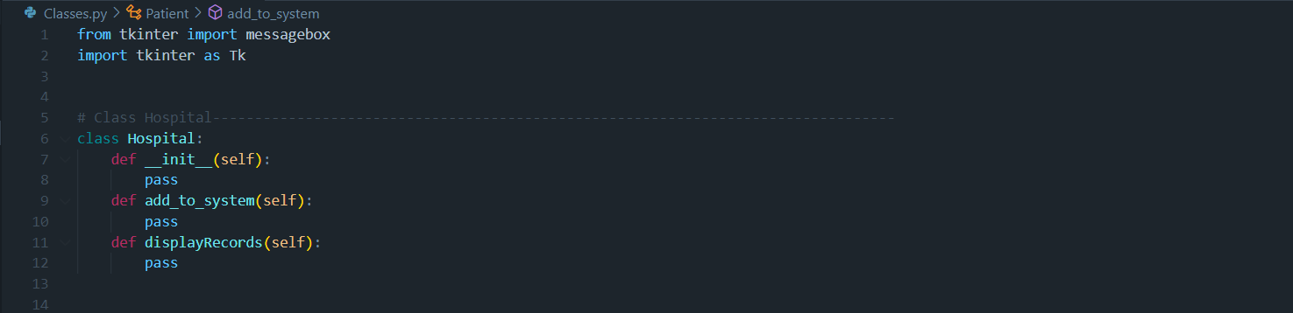

Classes
Class Hospital
This code sets up the structure for a Hospital class but doesn’t implement any functionality yet. It includes placeholders for methods (add_to_system and displayRecords), which could later be developed to add data to the hospital system and display records. The pass statements are placeholders that allow the code to run without raising an error, even though the methods don’t do anything yet.

Slide 3
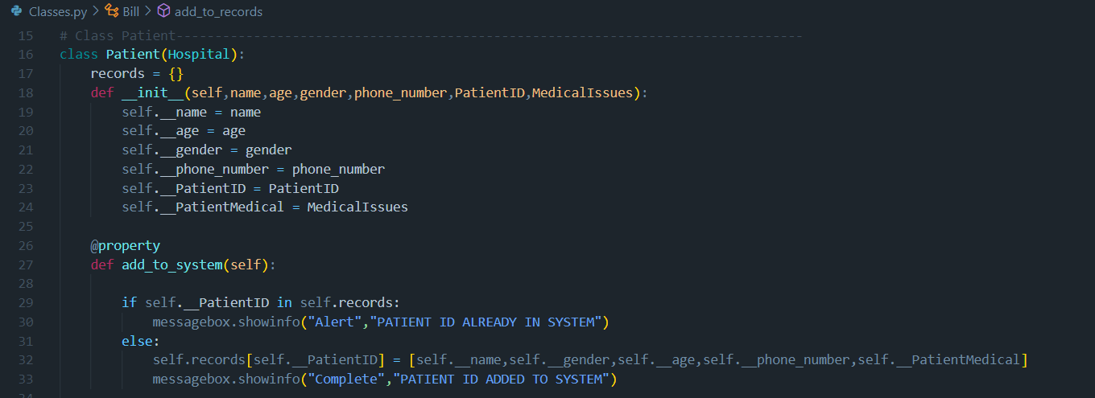
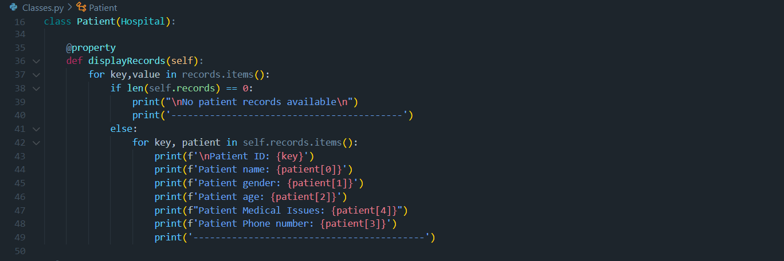

Classes
Class Patients
The Patient class manages patient records with:
Add to System: Checks if a PatientID already exists in Patient_records. If it doesn’t, it adds the patient’s details and confirms.
Display Records: Shows all patient records. If none exist, it displays a message indicating no records are available.
The Patient_records dictionary stores each patient’s information, ensuring unique identification by `PatientID`.

Slide 4

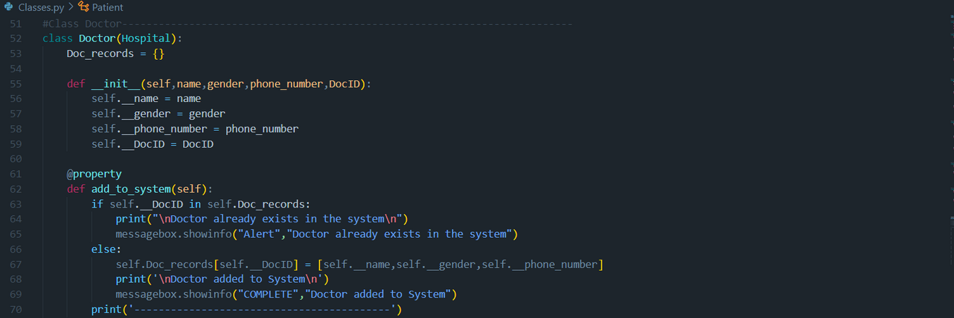
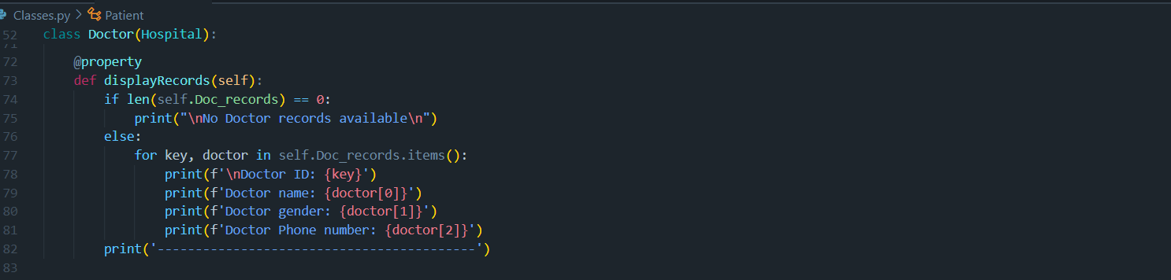

Classes
Class Doctors
This Doctor class, inheriting from Hospital, manages a record system for doctors. It includes methods to:
Add to System: Checks if a doctor’s DocID already exists in Doc_records. If it does, it displays a message indicating the doctor is already in the system. Otherwise, it adds the doctor’s details (name, gender, phone number) to Doc_records and confirms the addition.
Display Records: Shows all records in Doc_records. For each doctor, it prints their ID, name, gender, and phone number. If there are no records, it displays a message indicating that no records are available.
The Doc_records dictionary stores each doctor’s information using their DocID as the key.

Slide 5

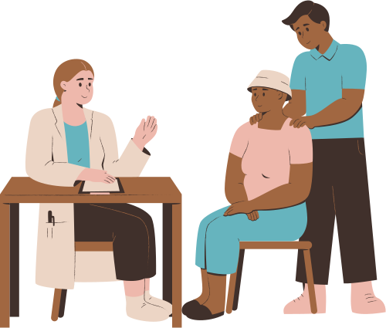
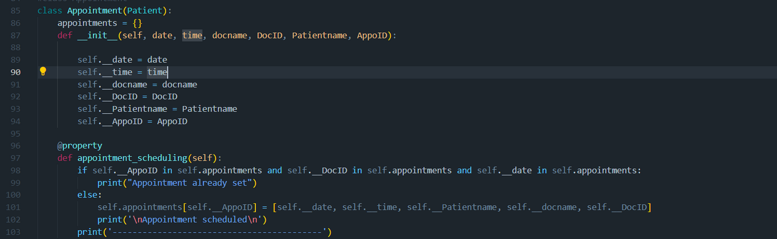
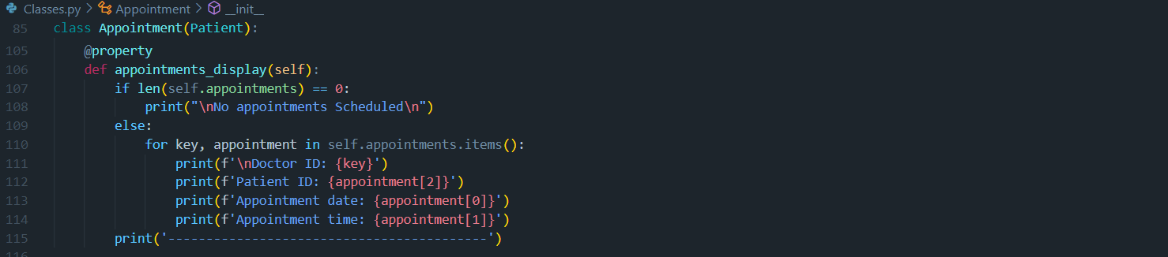
Classes
Class Appointment
The Appointment class, inheriting from Patient, manages appointment scheduling for patients and doctors. It includes methods to:
Appointment Scheduling: Checks if an appointment with the same AppoID , DocID, and date already exists in appointments. If it does, it displays a message that the appointment is already set. Otherwise, it adds a new entry with the appointment details (date, time, patient name, doctor name, and doctor ID) to the appointments dictionary and confirms the scheduling.
Appointments Display: Lists all scheduled appointments. For each appointment, it displays the doctor ID, patient name, appointment date, and time. If there are no appointments, it displays a message indicating no appointments are scheduled.
The appointments dictionary stores each appointment, with AppoID as the key.

Slide 6

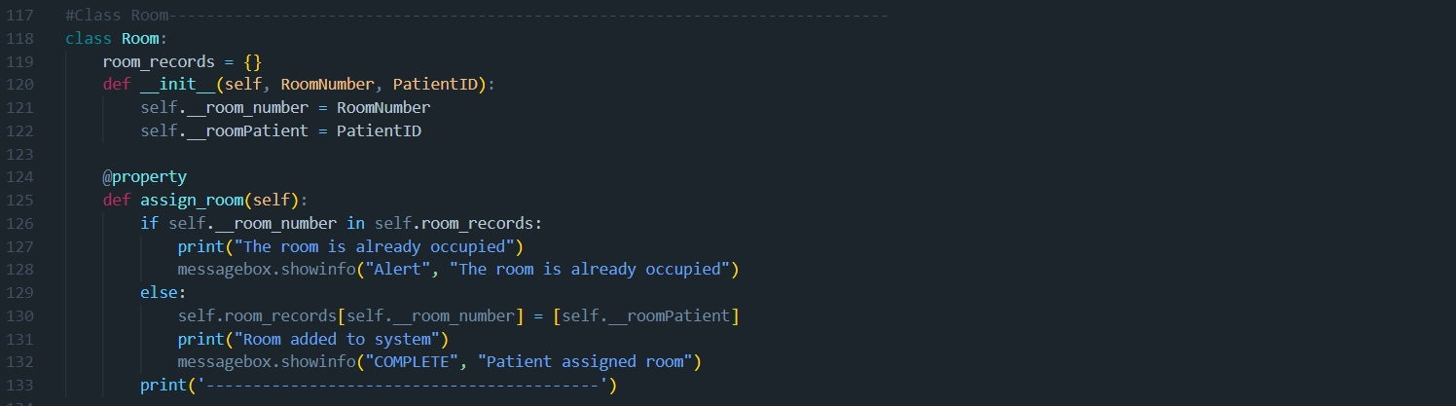
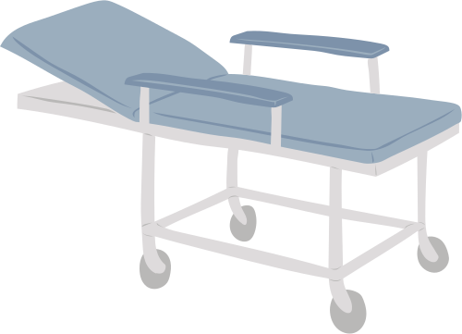
Classes
Class Rooms
The Room class handles room assignments for patients. It includes the following:
Attributes: Each room is assigned a RoomNumber and a PatientID.
Static Dictionary: room_records = {} stores the room assignments, with each entry keyed by RoomNumber.
Method:
Assign Room: Checks if a room (RoomNumber) is already in room_records:
If the room is occupied, it displays a message indicating that.
If the room is available, it adds the room to room_records with the assigned PatientID, confirming the assignment.
The room_records dictionary keeps track of each room and its assigned patient, ensuring only one patient per room.

Slide 7
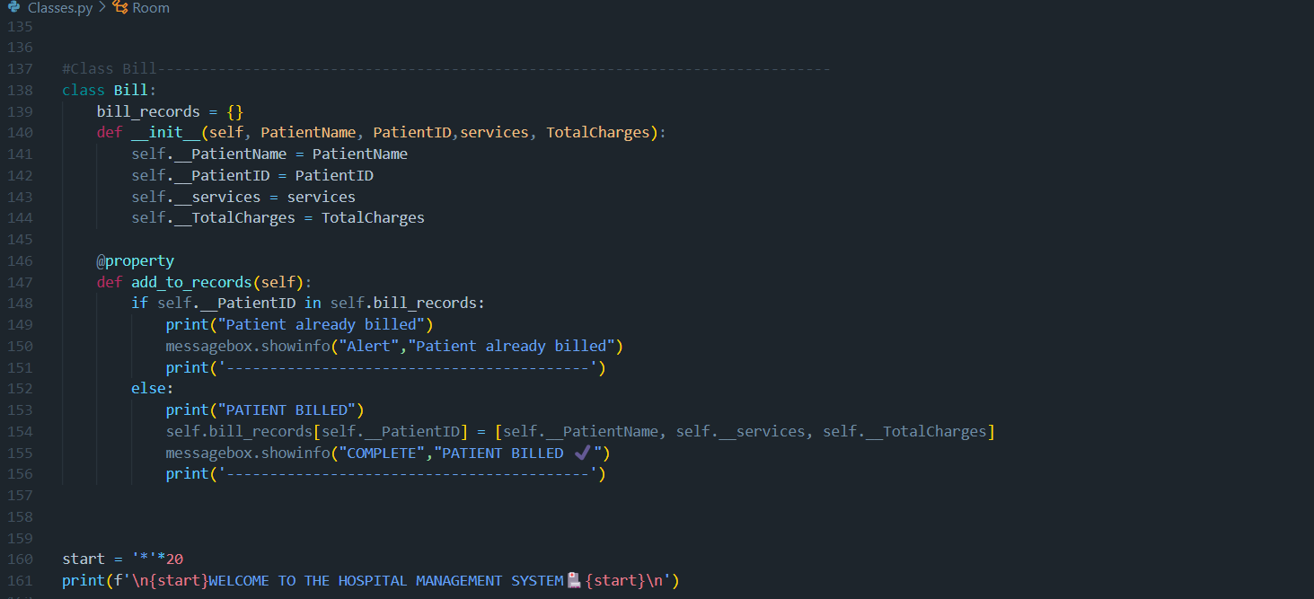

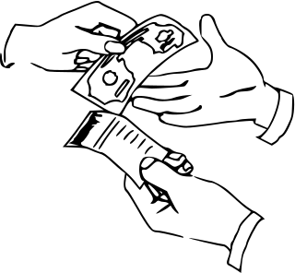
Classes
Class Bill
The Bill class manages billing records for patients. Here’s a breakdown:
Attributes: Each bill includes a PatientName, PatientID, services (list of services rendered), and `TotalCharges` (total billing amount).
Static Dictionary: bill_records = {} stores billing information for each patient, with `PatientID` as the key.
Method:
Add to Records: Checks if the PatientID already exists in bill_records:
If the patient is already billed, it displays a message indicating this.
If not, it adds the patient’s billing information (name, services, and charges) to bill_records and confirms billing.
The bill_records dictionary keeps track of each patient’s billing details, ensuring each patient is billed only once.
The code ends with a welcome message for the hospital management system, which is printed to the consol

Slide 8
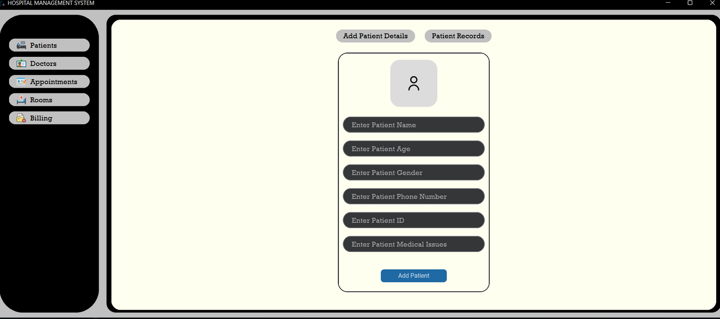
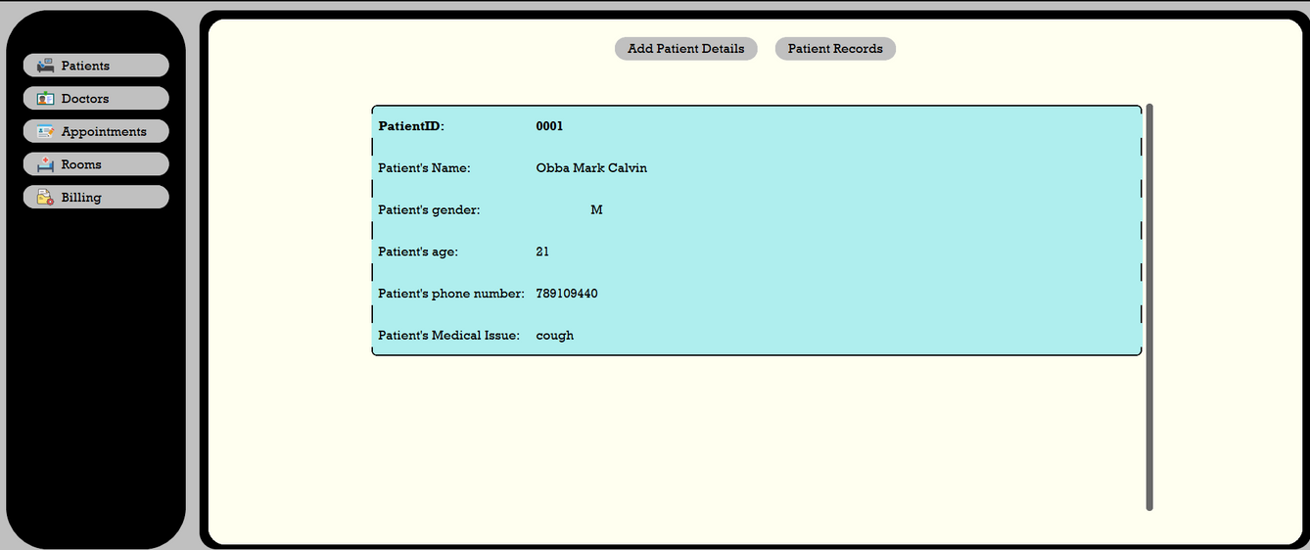
HOW IT WORKS
FOR CLASS PATIENT

Slide 9
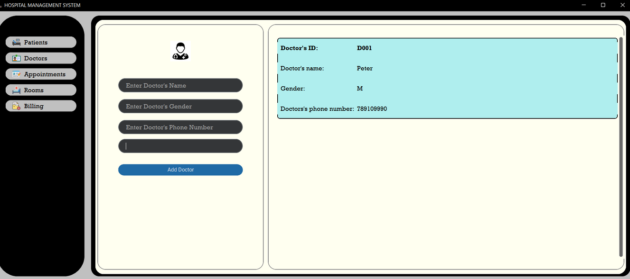
HOW IT WORKS
FOR CLASS Doctor

Slide 10
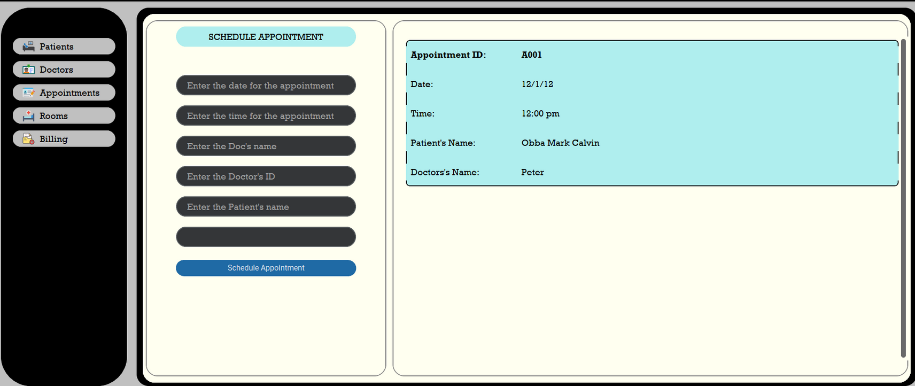
HOW IT WORKS
FOR CLASS Appointment

Slide 11
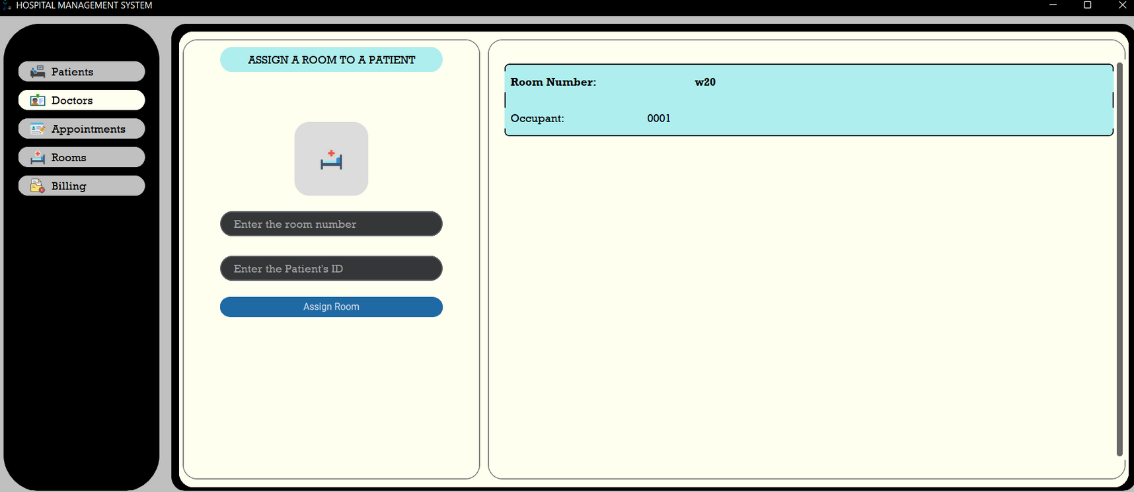
HOW IT WORKS
FOR CLASS Room

Slide 12
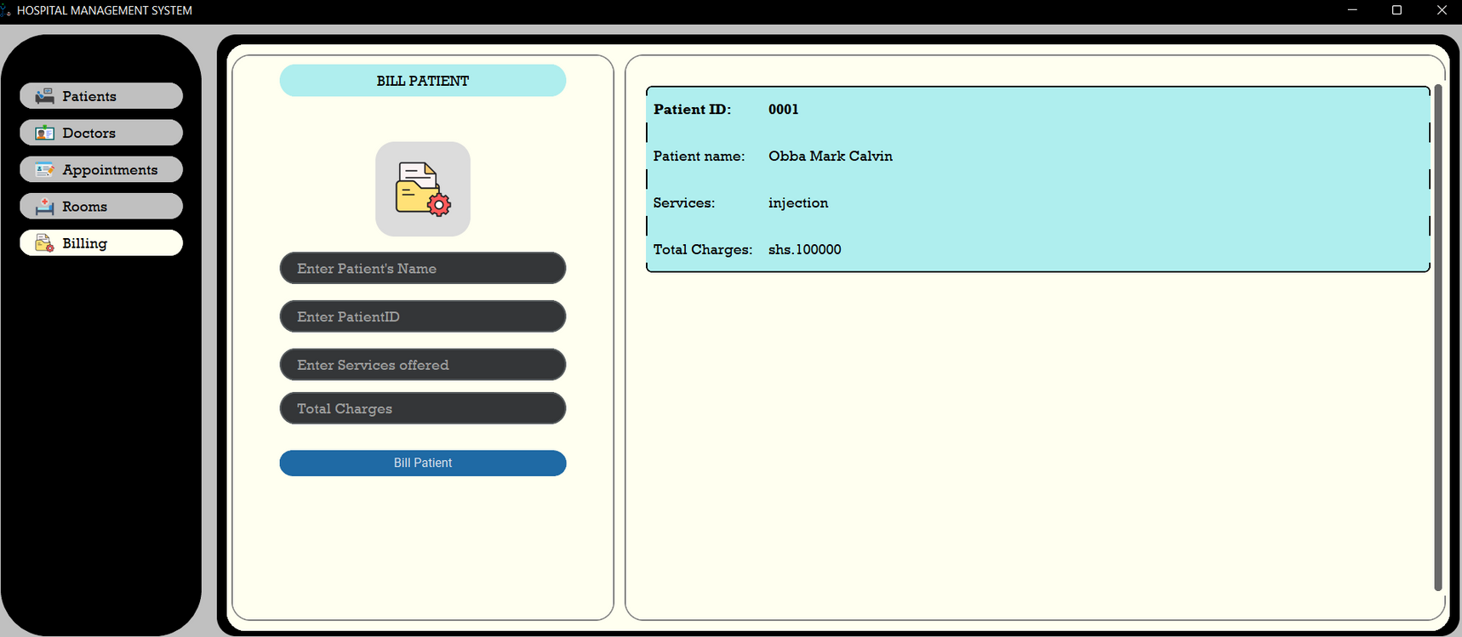
HOW IT WORKS
FOR CLASS Bill

